Slide 1
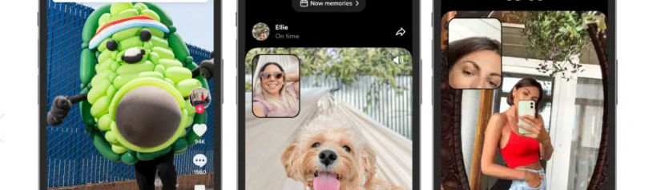
Speaking activity -Ban or Not:Tik Tok?
Dajana Jelavić
EFL teacher mentor
Jure Kaštelan high school Omiš

Slide 2
Do you agree or disagree with this statement?
Young people should not
be allowed to use Tik-Tok

Slide 3
Multi-faceted Speaking Activity
AI debate
FOR&AGAINST debate
Debate with a twist (SEL skills)
Socratic Seminar
Panel
Pecha Kucha

Slide 4
Outcomes
Students will be able to:
Express Opinions Clearly
Engage in Structured Debates
Use Media-Related Vocabulary
Demonstrate Active Listening Skills
Improve Pronunciation and Intonation

Slide 5
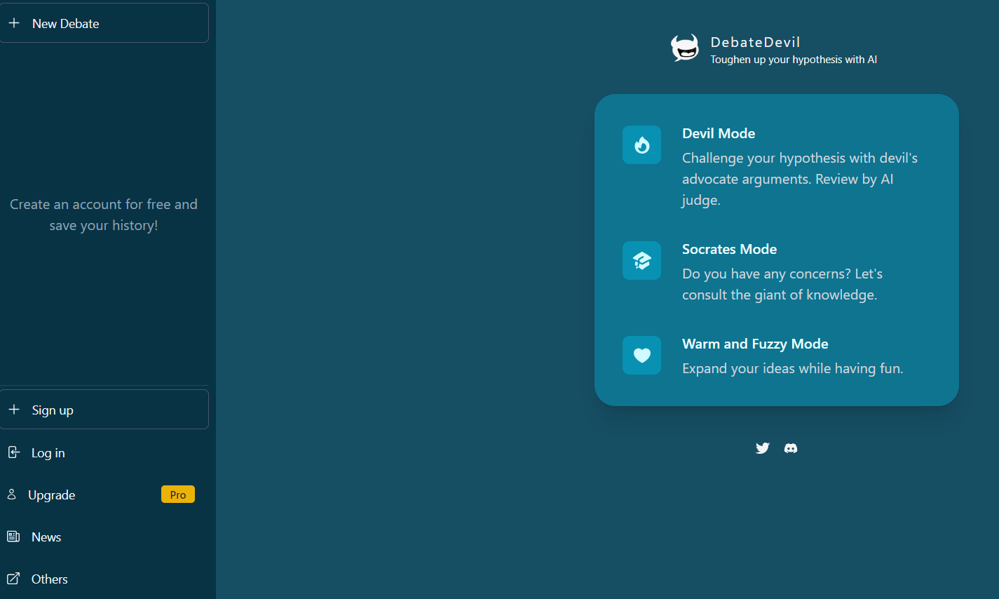
Warm-up Activity:Debating with AI
https://www.debate-devil.com/en

Slide 6
Debating
In this activity you’re going to take part in a debate.
Debating is a great way to practice several skills such as working together with classmates; finding, evaluating and discussing information; and asking questions, agreeing, and disagreeing.

Slide 7
Outline
The topic of this debate is young people’s media use
If you agree with the idea, you will be on the FOR Team
It may be difficult to argue for something you disagree with but it’s a good opportunity to look at something from a different perspective
FOR Team: Find information and prepare arguments with evidence on why young people should be allowed to use Tik-Tok
AGAINST Team: Find information and prepare arguments with evidence on why young people should NOT be allowed to use Tik-Tok

Slide 8
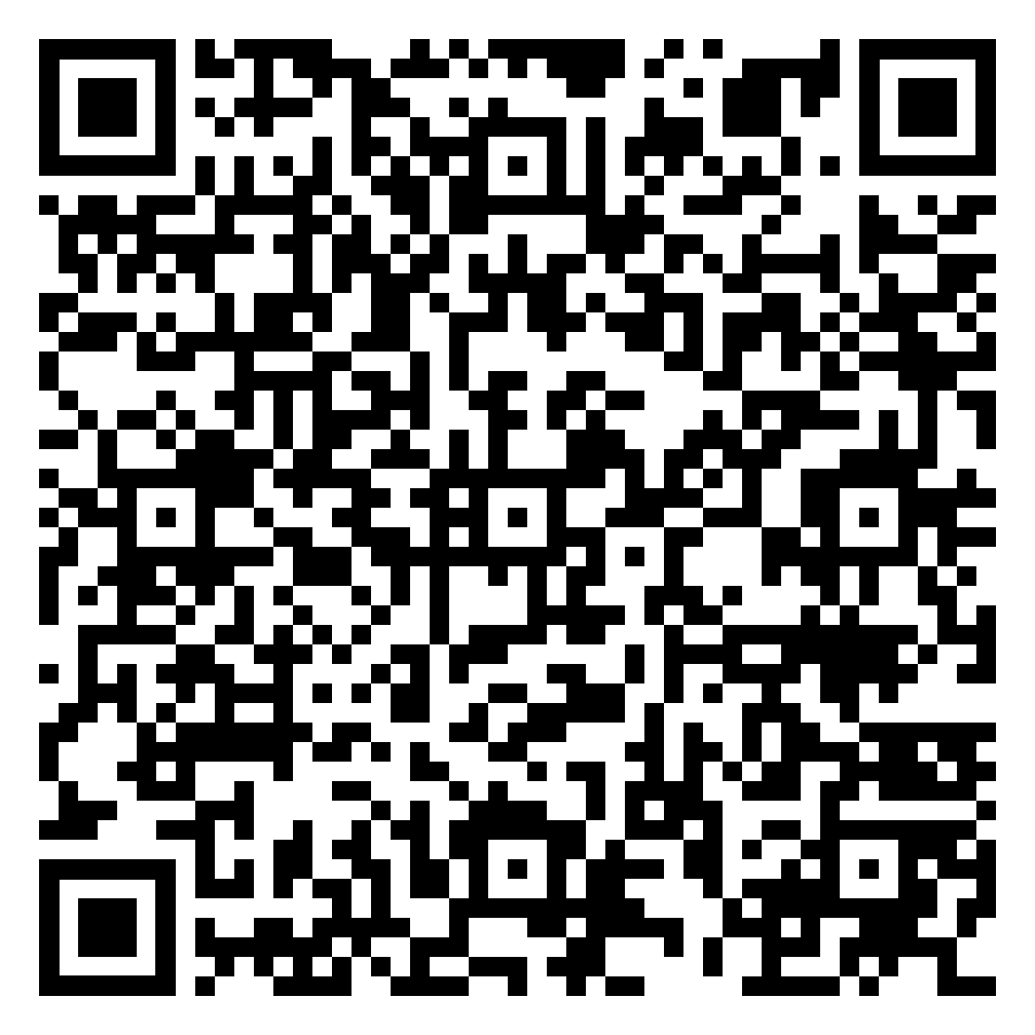
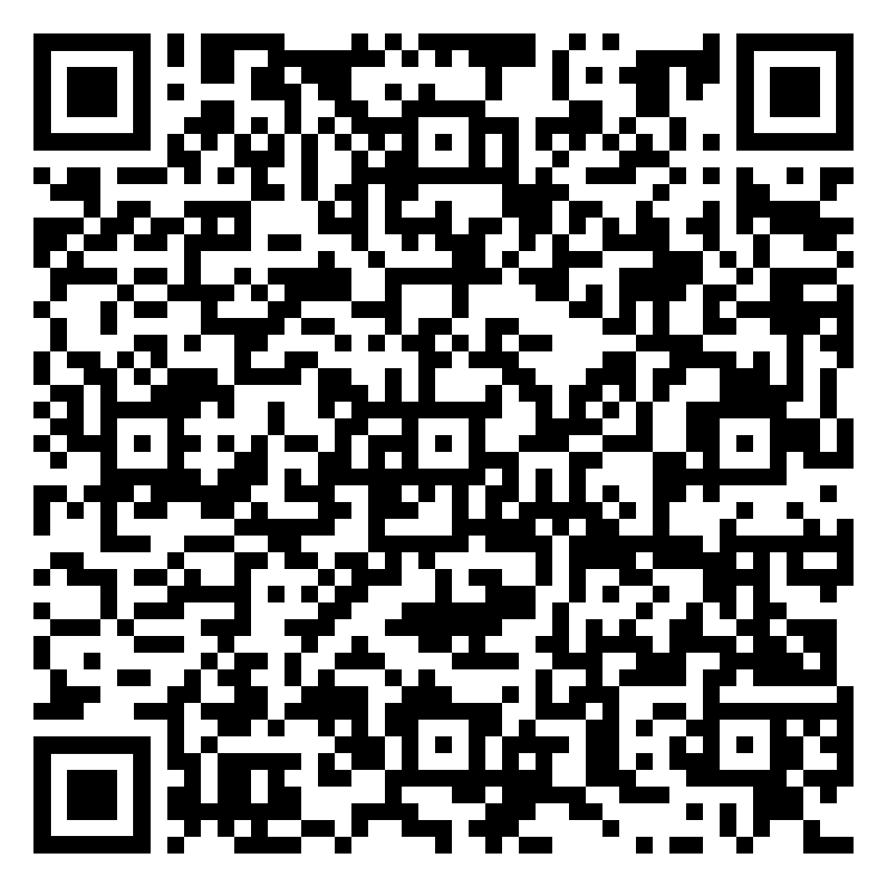
Handouts
Vocabulary for Tik Tok Debate
Expressions for Research and Debate
Review the language used in the handouts and make a note of any new
terms or phrases you come across during your research.

Slide 9
Debate with a twist
Organize a debate where, halfway through, students must switch sides.
This forces them to adapt their arguments and understand opposing viewpoints, promoting critical thinking and empathy.

Slide 10
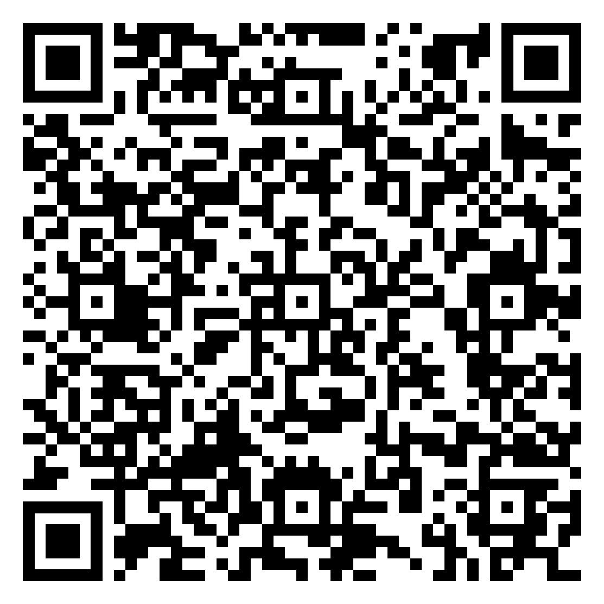
Assessment
Rubric for Tik Tok debate

Slide 11
Lesson Outline (Socratic Seminar)
Objective:
To engage students in a structured, student-led discussion to explore diverse perspectives on the topic while improving their speaking, listening, and critical thinking skills in English.
Warm-Up Activity (5 minutes):
Show a short video or infographic highlighting pros and cons of TikTok (e.g., its influence on young people, privacy concerns, creativity boost, and addiction risks).
Discuss initial reactions in pairs to activate prior knowledge.
Brainstorming Arguments (10 minutes):
Divide students into two groups: For (supporting the ban) and Against (opposing the ban).
Each group prepares key arguments and examples to support their stance.
Encourage them to think critically about TikTok’s impact on mental health, education, creativity, and social behavior.

Slide 12
Socratic Seminar
1. Inner and Outer Circle Setup:
Inner Circle: A small group of 6-8 students actively discusses the topic.
Outer Circle: Remaining students observe, take notes, and evaluate the discussion.
Rotate students between the circles to ensure everyone participates.
2. Discussion Guidelines:
Students in the inner circle engage in a respectful discussion, following these prompts:
Why do you think TikTok is beneficial or harmful for young people?
What are the potential risks of using platforms like TikTok?
How could young people use TikTok responsibly?
Students in the outer circle listen actively and provide feedback, using an evaluation form to note:
Clarity of arguments.
Use of evidence and examples.
Engagement and respect for differing opinions.

Slide 13
Socratic seminar
Teacher’s Role:
Act as a facilitator, guiding the discussion only when needed.
Encourage deeper reflection with open-ended questions like:
What evidence supports your claim?
How would you respond to someone who disagrees?
Whole-Class Discussion (5 minutes):
Share key points raised during the seminar.
Discuss any changes in opinions or new insights gained.
Individual Reflection (5-10 minutes):
Students write a short response to prompts such as:
What did you learn from the discussion?
What arguments were most convincing? Why?
How could you improve your participation next time?

Slide 14
Assessment and feedback
Speaking Skills: Clarity, fluency, and use of vocabulary.
Engagement: Respectful listening, turn-taking, and critical responses.
Reflection: Depth of insights in written responses.
Persuasion & Argumentation: present ideas logically and persuasively,use of supporting evidence, effectiveness in countering opposing viewpoints.

Slide 15
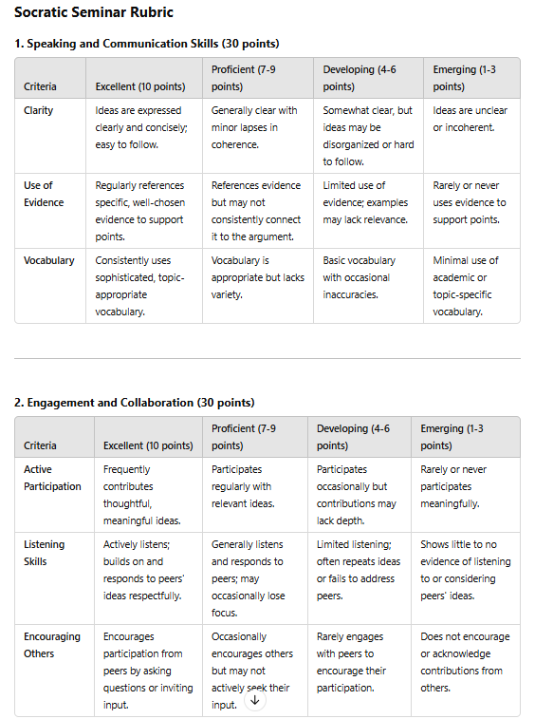
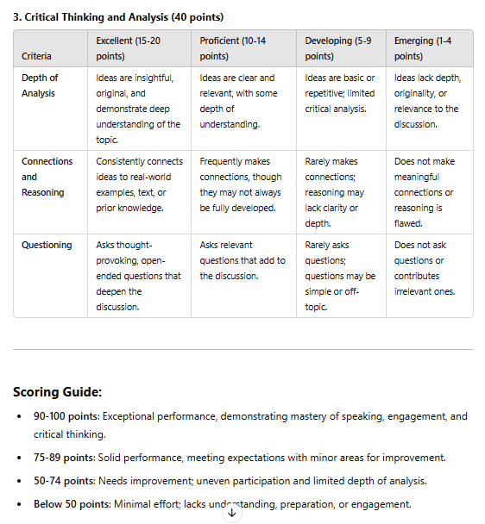

Slide 16
Panel
Assign Roles
Panelists (4-6 students):
Split evenly between "Pro-Ban" and "Anti-Ban" perspectives.
Panelists will represent specific stakeholders such as:
Government officials (e.g., lawmakers, cybersecurity experts).
Business owners (e.g., influencers, marketers).
Educators/Parents (concerned about youth mental health).
TikTok representatives (advocating for the platform’s benefits).
Assign each student a stakeholder role for authenticity
Moderator (1 student or teacher):
Guides the discussion, enforces rules, and
ensures equal participation.
Prepares 5-7 thought-provoking questions for the panel.
Audience (rest of the class):
Act as observers, note-takers, and questioners.
Prepare follow-up questions to ask during the
Q&A segment.

Slide 17
Research Topics
Each panelist researches their perspective, focusing on:
Data privacy and cybersecurity risks (Pro-Ban).
Freedom of expression and economic benefits (Anti-Ban).
Impact on mental health and addiction (Pro-Ban).
Creative and educational opportunities on TikTok (Anti-Ban).
Structure of the Panel Discussion
1. Introduction (5 minutes)
The moderator introduces the topic and explains the purpose of the discussion.
Briefly present the structure and ground rules:
Respect all speakers.
Avoid interruptions.
Stick to time limits.

Slide 18
Opening Statements (10 minutes)
Each panelist gets 1-2 minutes to present their initial arguments.
3. Guided Discussion (15 minutes)
The moderator poses 5-7 prepared questions, such as:
What are the main security risks associated with TikTok, and are they significant enough to warrant a ban?
How would banning TikTok affect small businesses, influencers, and the economy?
What role does TikTok play in shaping youth behavior, and does it need more regulation instead of a ban?
Is it fair to target TikTok when similar issues exist on other social media platforms?
How might a ban impact freedom of speech and cultural exchange globally?
Each panelist has 1-2 minutes to respond to each question. The moderator ensures balanced participation.
Audience Q&A (10 minutes)
Audience members ask follow-up questions or challenge specific points raised by the panelists.
5. Closing Statements (5 minutes)
Each panelist has 1 minute to summarize their position and final thoughts.

Slide 19
Assessment and Feedback
Rubric for Panelists
Content Knowledge (10 points): Accuracy and depth of arguments.
Clarity and Persuasion (10 points): Ability to articulate ideas convincingly.
Engagement (10 points): Responsiveness to questions and peers’ points.
Rubric for Audience
Participation (10 points): Quality of questions or notes taken.
Critical Thinking (10 points): Ability to challenge ideas constructively.
Debrief (5-10 minutes)
Moderator or teacher facilitates a reflective discussion:
What did we learn from different perspectives?
Were there any arguments that changed your opinion?
How does this apply to broader issues like social media regulation or digital ethics?

Slide 20
Pecha Kucha
Pecha Kucha (Japanese for "chit-chat") is a fast-paced presentation format where a presenter delivers a total of 20 slides, with each slide automatically advancing after 20 seconds. This format emphasizes concise storytelling, impactful visuals, and clear, focused communication, making it ideal for exploring complex topics in an engaging and structured way.

Slide 21
Steps
Understand the Format
20 Slides × 20 Seconds Each: You will have 6 minutes and 40 seconds total. Each slide should complement your message visually, while your spoken words expand on the idea.
Focus on one idea per slide to avoid overwhelming your audience.

Slide 22
Plan your content
Create an Outline: Break your topic into 20 key ideas or sections.
Introduction to TikTok
Privacy concerns
Cybersecurity risks
Mental health impacts
TikTok’s role in business
Freedom of expression, etc.
Allocate 20 seconds of speaking time per slide. Your script should match the timing perfectly.

Slide 23
Write and Rehearse Your Script
Write and Rehearse Your Script
Write Concisely:
Prepare a script that conveys your message within the 20-second limit per slide.
Avoid overloading slides with information. Let your words fill in the details.
Practice Timing:
Rehearse multiple times to ensure your speech matches the slide transitions seamlessly.

Slide 24
Tips for a Successful Pecha Kucha
Focus on Storytelling: Build a narrative that connects the slides logically.
1
Stay Engaging: Use your tone, body language, and expressions to keep the audience's attention.
2
Be Prepared: Know your content well to avoid reading directly from a script.
3
Visuals Over Text: Prioritize impactful visuals over lengthy bullet points.
4

Slide 25
Example Slide Breakdown
For the topic "Ban or Not: TikTok":
Slide 1 (20 sec): Title and introduction – TikTok’s popularity.
Slide 2 (20 sec): Privacy concerns with TikTok.
Slide 3 (20 sec): Cybersecurity and government fears.
Slide 4 (20 sec): Positive impacts on small businesses.
Slide 5 (20 sec): Youth addiction concerns. (Continue with similar breakdowns for all 20 slides.)

Slide 26
Pecha Kucha Rubric

