Slide 2
Ishodi
Nakon završenog izlaganja sudionici će biti sposobni:
koristiti podcast u svrhu ostvarenja ishoda svog predmeta
primijeniti PBL metodu u svom kontekstu poučavanja

Slide 3
Kratki pregled izlaganja
Erasmus+
školski radio kao alat u inovativnoj nastavi
Med Diet Declaration
Can Chard save the Earth?
PBL korak po korak
Anchor/Spotify
OER

Slide 4
Erasmus+ KA122 Inclusive.Digital.Innovative.-I.D.I. keeping pace with change Teaching assignment activity

Slide 5
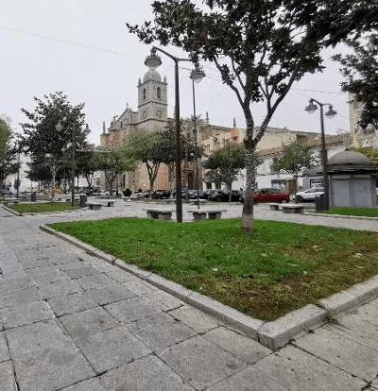
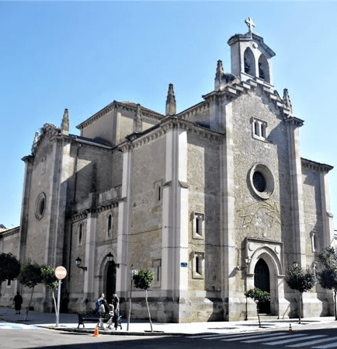
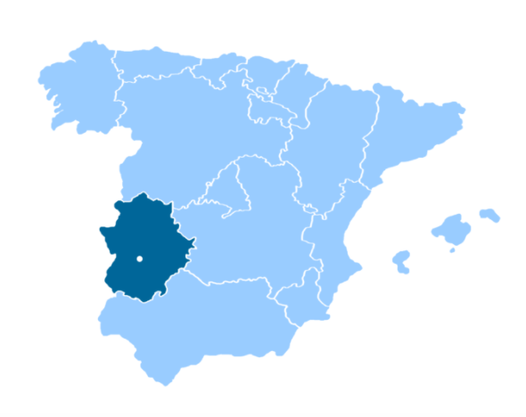
Don Benito

Slide 6
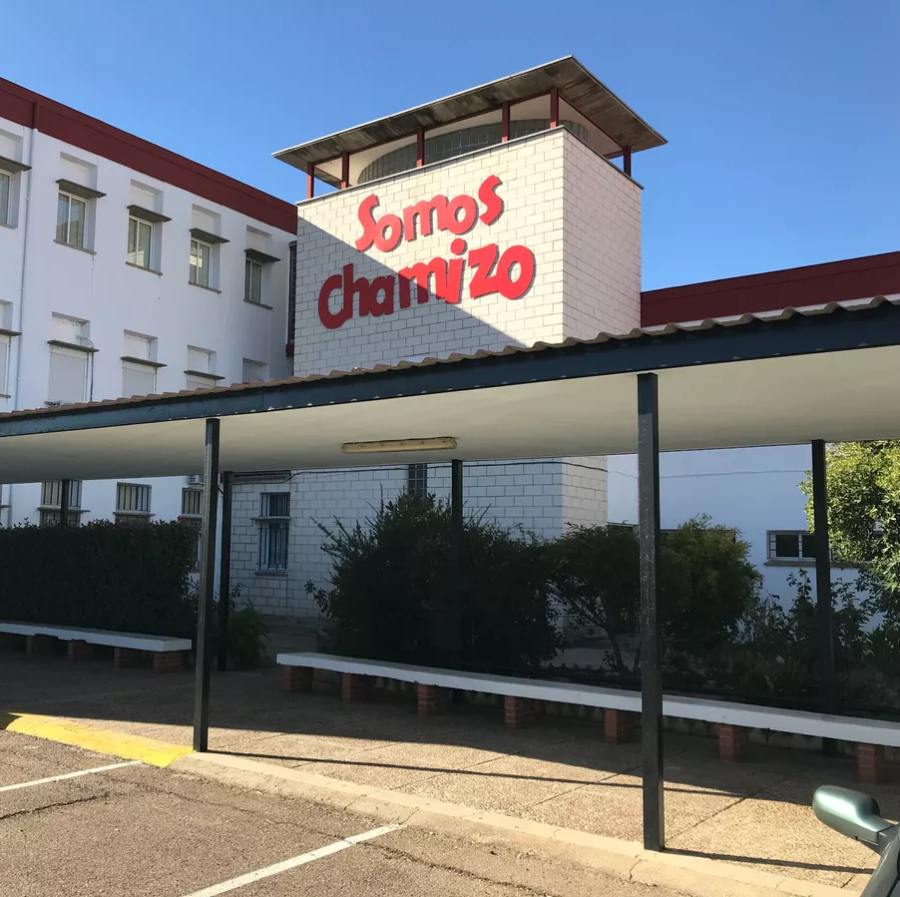
IES Luis Chamizo
VIDEO (school location)
SCHOOL TOUR IN ENGLISH

Slide 7
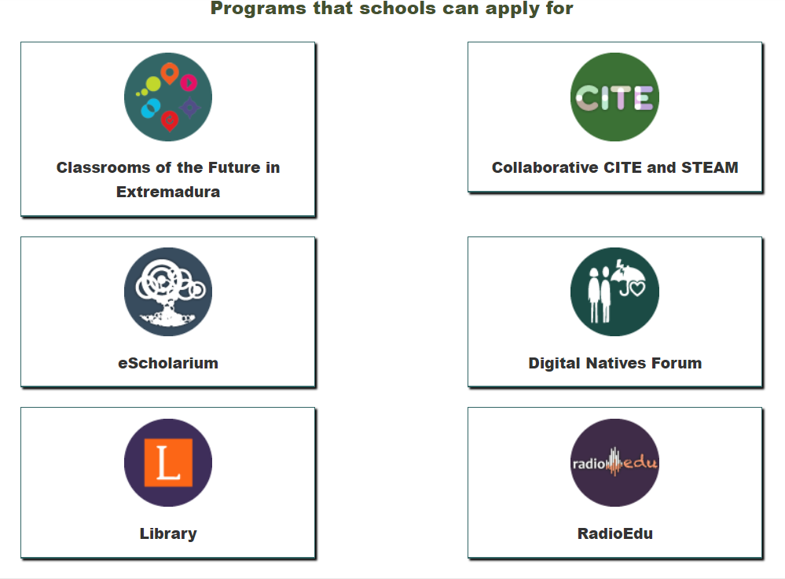
Innovated

Slide 8
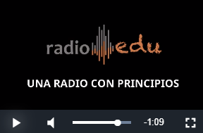
https://bit.ly/3FXa6g7 RADIOEDU

Slide 9
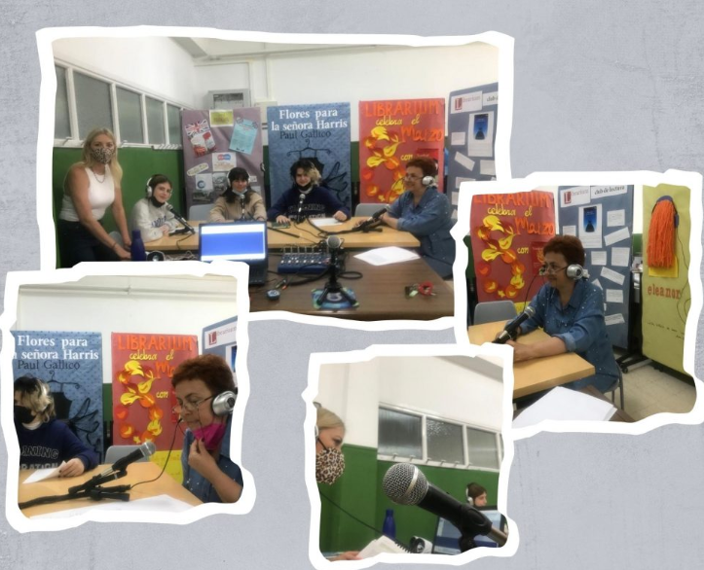
Chamizo Channel

Slide 10
Ostvarivanje ishoda iz kurikuluma

Slide 11
Klasični jezici

Slide 13
Koje bi ishode u svom predmetu mogli ostvariti uz pomoć radija?
ⓘ Start presenting to display the poll results on this slide.

Slide 14
Zašto radio?
ⓘ Start presenting to display the poll results on this slide.

Slide 15
PBL Can Chard save the Earth? podcasts
https://www.universityofcalifornia.edu/news/quiz-do-you-know-how-your-diet-affects-planet
Activating prior knowledge
Prerequisites (Poljica cookbook & videos)
Building/revising vocabulary
Making connections
Brainstorming

Slide 16
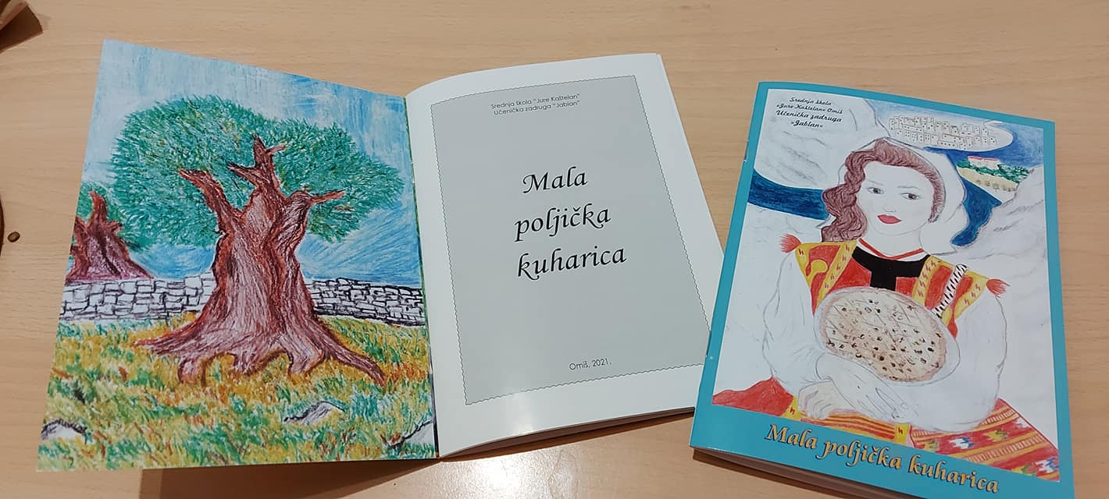

Slide 18
Goal
Students will be able to speak about the Mediterranean diet, local beverages, lifestyle,outdoor activities and the community
THINK globally,
EAT locally

Slide 19
Outcomes
Students
conduct research on an assigned topic
write a script for a radio programme based on a video
construct audio-stories with structure
record 5 episodes of the radio programme
develop the activity into OER
build confidence,self-esteem & agency
improve their speaking and listening skills & 4Cs

Slide 20
PBL step by step
https://docs.google.com/document/d/1DSRQKdj7R41EjYZcnwU4LvhDElO6RKCE7G-Fe7M0t5o/edit
PBL template
Assessment (exit ticket, checklist, peer review, rubric)

Slide 21
Korisni linkovi
https://toolsvalley.net/sound-effects/
https://freeplaymusic.com/
https://www.findsounds.com/ISAPI/search.dll

Slide 22
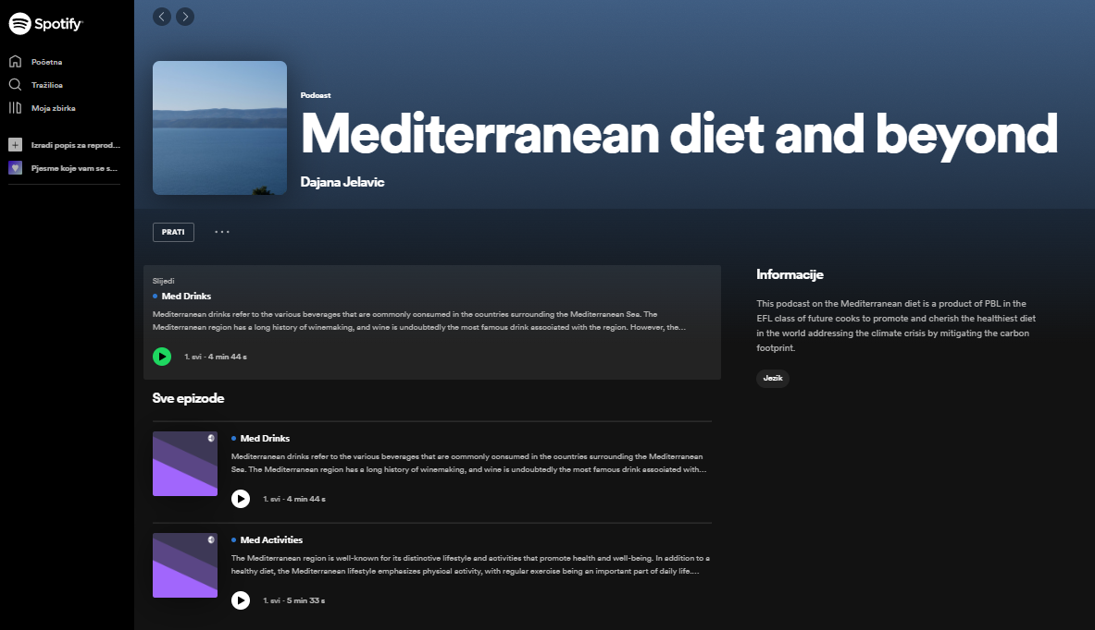
https://open.spotify.com/show/15akqcq849cd7q0Zs0unLy

Slide 23
Podcast episode (Med Drinks)
Comprehension check T/F
The most famous brands of white wine are Grasevina, Grk and Peljesac.
Sage is picked for tea and juice making.
Except wine Dalmatian people mostly drink natural juices.
Some famous beers here are: Pan, Ozujsko,Karlovacko.
In Dalmatia people especially hate Plavac Mali.
Orahovica is made from green plums.
Muljanje is a process which removes the stem from fruit. (Megi 3e)

Slide 24
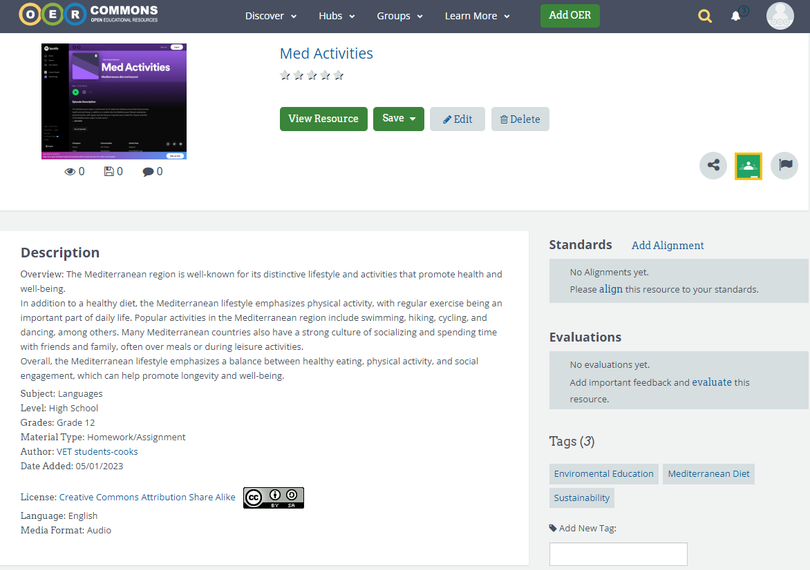
https://www.oercommons.org/

Slide 25
Exit card for participants T/F
There is only formative assessment
There is a driving question
Receptive and productive language skills are integrated
The topic is relevant and connected to real life
Teacher provides scripts
21st century skills are being shaped
Different literacies are addressed (information,digital,media)
Students are in charge of their learning
The results are shared for educational purposes
The process and the product are assessed

Slide 26
Benefits (in general)
Auditory learners
New channel for accessing information
Non-native speakers
For online lessons to transfer content
Teachers can reconsider their lectures
Suplementary learning materials
Storytelling;reflective diaries,summaries
Accessible anytime, anywhere
Self-evaluation, peer-review
Skills development through creation

Slide 28
Describe this lecture with an adjective.
ⓘ Start presenting to display the poll results on this slide.

Slide 29
Hvala na pozornosti
dajanajelavic@gmail.com

