Slide 1
Notes:
​​Good afternoon ,my name is Dajana Jelavić and I am a teacher mentor at Jure Kaštelan high school in Omiš,Croatia.​​
In this presentation I am going to show you how to engage students in a creative task building seamlessly and simultaneously all 4Cs.​​​
Hope you will find it interesting and helpful.
​

Slide 2
Learning outcomes
Students will be able to justify their opinions & choices orally & in writing
Students will be able to write a letter collaboratively
Notes:
These are two main learning outcomes:----------

Slide 3
Lesson outline
Warm-up: dream catchers
Word cloud with key words /predicting
Jigsaw reading of an authentic article
Retelling the dreams to the class
Choosing 4 outstanding persons/disCussion
Writing a letter collaboratively
Wrap-up: Reflecting on lesson
Notes:
Let's go briefly through all the phases of the lesson following this outline

Slide 4
Notes:
To help students prepare for the reading activity by activating the relevant schemata,teacher puts questions about the topic encouraging students to draw on their own experiences.e.g.
What is a dream catcher?
Have you ever caught your dream? Tell us more about it! Where were you? What did you do? How did you feel?Would you like it to become true and explain why?

Slide 5
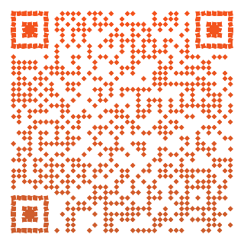
Notes:
After personal stories and dream experiences it’s time for reading.Each student is assigned different part of the article that is hidden in this qr code.
10 dreams that changed human history is a newspaper article about 10 remarkable dreams that somehow influenced and changed the course of human history.
Before doing jigsaw reading activities in mixed classes I suggest applying Readability text analyzer to gauge readability of each paragraph.This way technology enables us assigning easier parts of the text to lower-proficiency students.Providing differentiated materials teacher applies student-centered approach and gives opportunity to everyone to achieve better results.
So,whenever we want certain text to be fully benefited,we have to adapt it to ss language ability.

Slide 6
Notes:
At this point teacher generates word clouds for low-achieving students and ask others to create their own clouds containing most relevant words from their part of the article.​Now everyone has one’s own piece of authentic text accompanied by proper word cloud.
Next step is speaking activity in pairs.Ss swap their clouds and start predicting what that dream might be about.They put questions to each other based on word clouds trying to figure out a story of the dream.E.g. Is it about a king who has a sewing machine? Are there any warriors with spears in that dream? And so on & so forth…Teacher gives support on demand.And now question for you?
Can you see any C (at least one C) in this part of the task?(yes,predicting can lead to completely different story. When imagination kicks in,everything is possible).Ss need such moments when they feel free to speak & express themselves
without constraints. These are precious moments when they also develop their speaking skills to the greatest extent
Is there any collaboration involved?
What about communication? And there is also a lot of analysing,guessing,predicting,questioning what proves critical thinking presence.

Slide 7
Notes:
After a lot of guessing & inventing Ss feel curious to hear the true story.Now every s retells her/his part of the article to the class.Ok,now all the dreams are revealed and Ss have to take into consideration all of them & choose just 4 outstanding persons whose dreams contributed most to humanity according to their opinion.Before voting there is discussion in class where Ss defend their claims and justify their choices. The purpose of this discussion is to provide the argumentative structure that can be used later to develop the writing assignment.
Teacher facilitates discussion based on students’ answers.

Slide 10
Notes:
At this point 4Cs /celebrities are chosen and soon will be honoured. Argumentative oral practice leads to writing task.

Slide 12
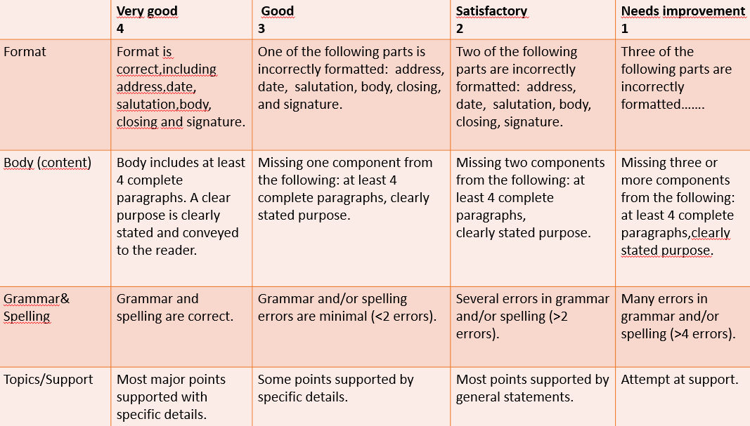
Notes:
A rubric with criteria that should be met in collaborative letter writing is given to Ss before they start writing.

Slide 13
Peer Assessment
Even better if…..
(suggest some improvements)
 | Yes | No | Sometimes
Do they write the recipient address?
Do they write their address?
Is there a date?
Is there a formal greeting and sign off?
Do they use proper vocabulary?
Does it flow nicely? Is it easy to follow?
Do they have paragraphs (good structure)?
Are their opinions supported well?
Notes:
Involving Ss in assessment is a great way to develop critical thinking skills and they should be given every opportunity to do it After certain time there is less bias in their judgement,they do their best to be fair and objective and expect the same from their peers.
Let students read other group’s letter and formulate a feedback according to this checklist offering additional suggesstions for improvements.
This leads to the overall reflection,feedbacks and impressions are shared with the rest of the class while mistakes are being orally discussed

Slide 14
Reflection
Resolving conflict,
Sharing responsibilities,​
Brainstorming,​
Decision-making​
Problem-solving,​
Comparing&​Contrasting,​
Explaining,​
Analysing​
Critical thinking
Collaboration
Communication
Writing,Speaking,​
Evaluating information,​
Active listening,​Reading,
Using technology​
Designing,Creating​,​
Generating ideas,
Improvising,​Innovating
Creativity
Notes:
HAVE YOU SPOTTED ALL 4Cs IN THIS ACTVITY? WHAT THINKING ABILITIES,SKILLS AND PROCESSES are needed to build 4Cs?Let’s find out together.
Which C hides in the first rectangle,yes,these are components of collaboration.Can you remember any collaboration in the presented activity.if any?OK,thank you.What would you add to this list,sth really important that shouldn’t be omitted.Collaboration means working together to achieve a common goal To build collaboration skills Ss have to learn to:Work effectively with different groups of people,to Be flexible and willing to compromise with the group members,to Be responsible and so on…SECOND SKILL involves logical thinking and reasoning including classification, cause/effect, patterning, forecasting, planning,explaining,gathering relevant information,a lot of curiosity and questioning.Did Ss need to apply ct to accomplish this activity?When,can you think of an example?THIRD SKILL is about Expressing thoughts and ideas clearly, giving opinions or instructions using different digital media.Can all the mentioned components be found throughout the activity?Is there anything you consider important and want to add? FOURTH SKILL involves ability to produce new, diverse and unique ideas, teaches ss to think outside the box taking advantage of their own different perspectives.
Do you find the activity creative in certain ways? Does it enhance creativity & innovation?
Thanks for your contribution ,I will surely update these lists….with your ideas.
We have just proved that this is a real dream task with 4Cs.We’ve reflected on the activity collaboratively as critical thinkers,communicating all the time in creative way,haven’t we?
Thank you very much for your attention.

