Slide 1
AI-powered Innovative Teaching for Gifted students
Gifted students have unique needs that require personalized solutions. Advances in AI have made it possible to harness technology to identify and nurture their potential.
Dajana Jelavić
English teacher mentor
Jure Kaštelan High School, Omiš

Slide 2
What is AI…
According to the European Parliament, “AI is the ability of a machine to display human-like capabilities such as reasoning, learning, planning and creativity. AI enables technical systems to perceive their environment, deal with what they perceive, solve problems and act to achieve a specific goal. The computer receives data - already prepared or gathered through its own sensors such as a camera - processes it and responds. AI systems are capable of adapting their behaviour to a certain degree by analysing the effects of previous actions and working autonomously”

Slide 3
AI literacy-critical skill & moral imperative
"Technological change is exponential while human adaptation is linear"
"The recent explosion of ChatGPT is just one example of the exponential rate of technological change: It took Twitter two years to reach one million users, Facebook seven months, and ChatGPT just five days."

Slide 4
Outcomes…
Familiarise yourself with various AI tools and applications available for education
Gain the ability to integrate AI tools into lessons and activities to unleash student creativity
Learn the innovative practices for implementing AI in the classroom
Embrace strategies for developing engaging lesson plans for the gifted
Boost self-confidence in using AI to support student learning and growth

Slide 5
Some traits….
Early use of metacognitive skills to manage their own thinking processes
Speed and efficiency of information processing
Motivation and curiosity in a search for understandings
Independence at challenging, non-routine tasks
Tolerance of ambiguity
Wide-ranging interests
Willingness to take risks
Draw inferences
Longer than usual concentration span on challenging topics of interest (but may ‘flit’ from one activity to another if activities are not challenging enough)
Responsivity to novel stimuli
An intense focus on or the ability to immerse themselves in an area of interest, in order to achieve a depth of understanding
Openness to new ideas and experiences

Slide 6
Let's dive into the AI stuff……..
Would you rather embrace AI-powered virtual reality for interactive and immersive learning experiences, or prefer traditional classroom settings for face-to-face interaction and social development?
Would you rather embrace AI-driven adaptive learning platforms that personalize educational content based on your needs, or prefer a fixed curriculum where you have greater control over what and how you learn?
Would you rather have an AI tool that automatically completes all your assignments but insists on citing only Wikipedia as a source or an AI tool that helps you discover new research avenues but only communicates through Morse code?
(serious)
(intellectual)
(absurd & hilarious)
https://autoclassmate.io/would-you-rather-question-generator-responses/?eid=88c029

Slide 7
Why …..would you rather?…….
Promote critical thinking:
force students to think critically about the choices they are making
consider the pros and cons of each option and make a decision based on their own values and preferences
Encourage creativity:
spark creativity in students
come up with new and innovative ways to solve problems
Build teamwork:
build teamwork in students
work together to come up with a consensus answer
Enhance communication:
help to improve communication skills in student
clearly articulate their thoughts and ideas to others
Learn about different perspectives:
learn about different perspectives
consider the viewpoints of others and see things from a different point of view
Have fun:
a fun way to learn and engage students
used in a variety of settings, such as classrooms, clubs, and even family gatherings

Slide 8
What do the gifted need to thrive?
Low skills / high challenges = anxiety
Low challenges / high skills = boredom
High challenges / high skills = FLOW
Mihaly Csikszentmihalyi (miːhaɪ ˈtʃiːksɛntmiːˌhɑːji)ː, "Flow: The Psychology of Optimal Experience", New York: Harper & Row, 1990.

Slide 9
Strategies….
Creative learning style
OTHER USE New options? Modified? What other ideas?
CHANGE Turn around? Change meaning, color, motion, sound, names, forms ? Other changes?
INCREASE What to add? More what? Greater frequency? Harder? Higher? Longer? Additional content? Doubling? Multiplying? Exaggeration? Smaller? More compact? Minimized? Lowered? Short? Reduce weight? Drain - eliminated? Divide?
REPLACE. What instead? Other ingredients? Another material? Another process? A different approach? Another tone or voice?
TRANSFORM Replace components? Different appearance? A different sequence? Replacing the cause of the result?
RETURN Replace the negative with the positive, or vice versa? What about conflicts? Replace the starting point? To change the application? See the other side? What about taste, composition, aroma, assortment ?
COMBINING Combining units? Combining purposes or ideas?
Inquiry-based Learning
open-ended investigations that lack a single correct answer
they enjoy the challenge of exploring various possibilities
Interdisciplinary Approaches
a strong aptitude for integrating different academic disciplines into a single study or project
excel at synthesizing and analyzing information from multiple fields
Complexity
lesson plans that foster deep exploration
excel at understanding cause-and-effect relationships
skilled at analyzing multiple variables from different perspectives
Appropriate Differentiation
essential to meet their unique learning needs and encourage their full potential
opportunities for independent research, creative projects, or real-world applications
flexibility in the assignment format and assessment methods
digital technologies to facilitate students' self-regulated learning skills and autonomy

Slide 10
AI
autoclassmate.io
character.ai
chatGPT
classX
bard
curipod
eduaide.AI
wepik.ai
conker.ai
studio.d-id
https://www.supermeme.ai/
https://www.debate-devil.com/en
https://interviewsby.ai/
https://test-english.com/
https://pallyy.com/tools/tweet-generator

Slide 12
Beyond text: Empowering Equality through Literature,AI and Social Media
or
Pride and Prejudice (Jane Austin)+AI tools+SDG 4(inclusive education)+SDG5 (gender equality)+social media(Twitter)
Objective: Empower students to critically analyze themes of inclusive education and gender equality in Jane Austen's "Pride and Prejudice." Utilize AI tools and social media platforms like Twitter to enhance their understanding and encourage them to become advocates for these issues.
Outline of the lesson
Warm-up
Would you rather questions…on gender equality https://autoclassmate.io/tools/would-you-rather-question-generator/
Malala's story: Fighting for Education Against Gender Bias
Read P&P onlinehttps://www.janeausten.org/pride-and-prejudice/pride-and-prejudice-online.php
Audiobook with readable texthttps://youtu.be/ZhxqauL9WbM
Book Chat
https://classx.org/book-chat/ (advanced)
Chat with AI about the book (chapter) you are reading
Characters' chat
https://beta.character.ai/
innovative storytelling
new level of immersion
Activation and Engagement Activity Generator
https://autoclassmate.io/tools/activation-and-engagement-activity-generator/
Do the quiz
https://app.conker.ai/create
(19th,20th,21st century)
Mock Oprah show
Microblogging with Twitter
https://pallyy.com/tools/tweet-generator
concise & effective communication
https://bard.google.com/chat
formative assessment
literary analysis
Tweets' generator
https://pallyy.com/tools/tweet-generator
Tweets into memes
https://www.supermeme.ai/
Collection of memes
summarize chapter
ice-breaker
formative assessment
discussion teaser
self-expression on an issue
Collaborative writing with ChatGPT
creative writing
Structured Debate with ChatGPT & Debate Devil
https://www.debate-devil.com/en
Elizabeth applies for a job
https://interviewsby.ai/
DOK level 3&4 questions
Assessment

Slide 13
Warm-up:
1.Would you rather…on gender equality
Would you rather live in a society where women are not allowed to pursue higher education or in a society where women cannot hold any leadership positions?
Would you rather be forced into early marriage with a man chosen by your family or live a life without the possibility of marriage or starting a family?
Would you rather be regarded as an object to be bought and sold or be treated as an equal human being in society?
Would you rather be paid significantly less than your male counterparts for doing the same job, or face constant discrimination and bias due to your gender?
Would you rather live in a world where women are denied basic reproductive rights or a world where women are denied the right to vote?
Would you rather be judged solely based on your physical appearance or be valued for your intelligence and skills?
Would you rather live in a society where domestic violence is widely accepted and normalized or a society where rape culture is prevalent?
Would you rather be denied opportunities for career advancements solely because of your gender or be forced to conform to traditional gender roles against your will?
Would you rather be constantly shamed and belittled for your choices as a woman or be denied the freedom to make choices regarding your own body and future?
Would you rather live in a society where women are objectified and sexualized in the media or a society where women’s achievements and intellect are often ignored?
https://autoclassmate.io/would-you-rather-question-generator-responses/?eid=fd93c7
Rationale…..
provoke curiosity
effective ice-breaker
enhance critical thinking
make better decisions
enhance communication
foster creativity
build teamwork
learn about different perspectives
set a positive tone
enhance argumentation skills

Slide 14
2.Malala's story:Fighting for Education Against Gender Bias

Slide 15
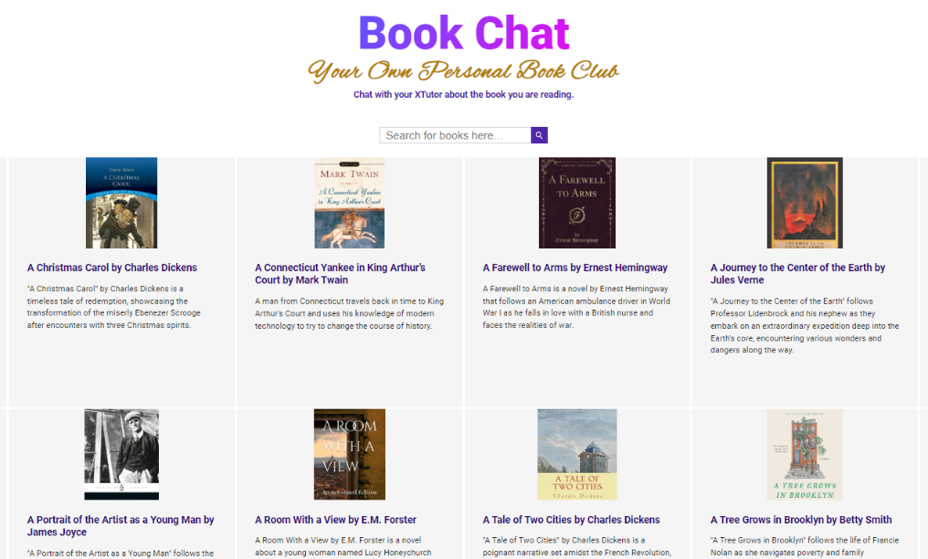
https://classx.org/book-chat/

Slide 16
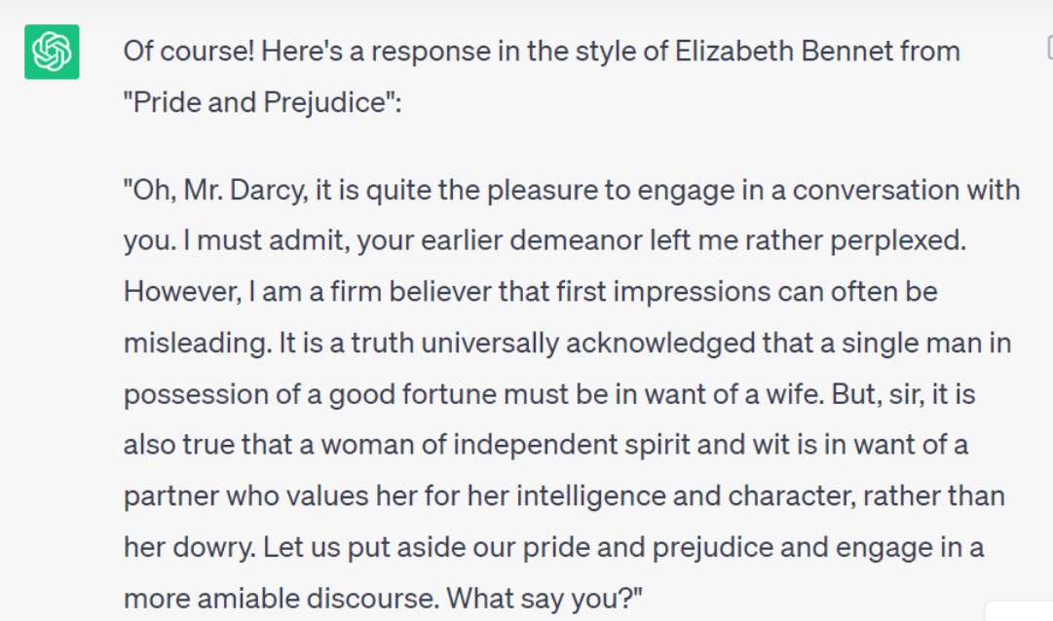
Chatting with ChatGPT

Slide 17
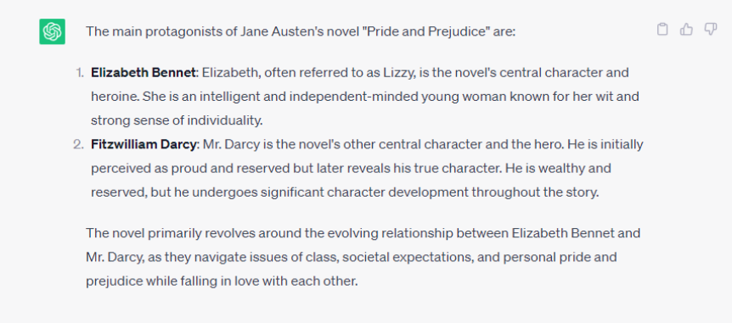
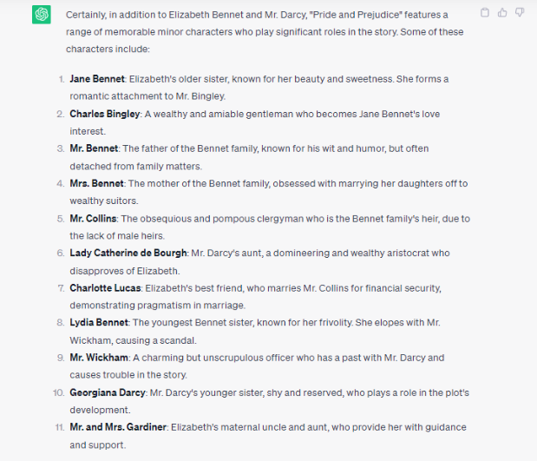
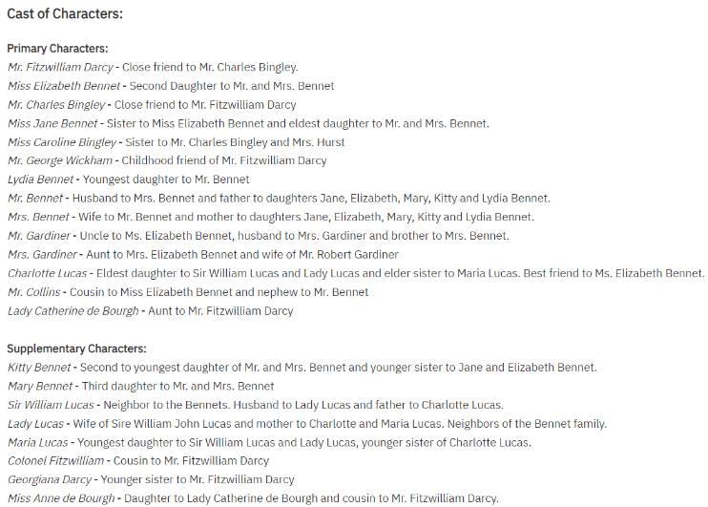
Ask ChatGPT….
https://www.janeausten.org/pride-and-prejudice/pride-and-prejudice-online.php

Slide 18
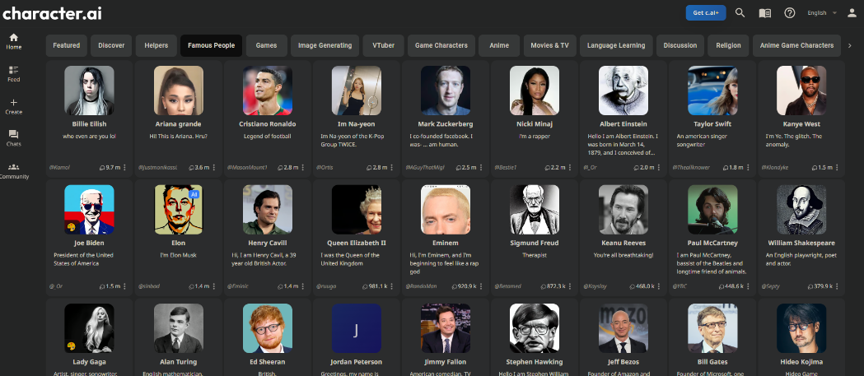
Create a character/room
Room Name (Pride & Prejudice)
Add Characters (Create a character and join this room)
Room Topic (Gender equality, Women status in society, Chapter 8,,,,,,,,)
https://beta.character.ai/signup

Slide 19
Character.AI
No more linear narratives
Innovative storytelling by character. AI
Create their own characters or select from a diverse range of pre-made characters
Students control the plot and decide what happens
Interactive narratives and role-playing
Individualized user-chosen storylines
Unleash imagination in unimaginable ways
An entirely new level of immersion
When AI bots contact with more humans, they learn and adapt to become more efficient and humanlike
They are better able to understand patterns of thought, behavior, and conversational outcomes

Slide 20
Activation and Engagement Activity Generator
Grade level….11th
I want students to learn….About gender equality through 19th,20th and 21st centuries
Lesson 1: “Time Travel through Gender Roles”
Lesson 2: “Gender Equality Comic Strip”
Lesson 3: “Interactive Timeline of Gender Equality”
Lesson Plan and Activity Forecast Tool
potential positive & negative outcomes of the activity
https://autoclassmate.io/tools/activation-and-engagement-activity-generator/
https://autoclassmate.io/tools/lesson-plan-activity-forecast-tool/

Slide 21
Do the quiz before Talk show…
Gender Roles and Expectations in the 19th Century
Gender Roles and Expectations in the 20th Century
Gender roles and Expectations in the 21st Century
https://app.conker.ai/activity/0

Slide 22
Mock Oprah show
Potential topics:
Women's Empowerment
Love and Relationships
Overcoming Prejudice
Resilience and Perseverance
Education and Self-Improvement
Sisterhood and Family Dynamics
Social Class and Equality
Literature and Reading
Legacy and Impact

Slide 23
Talk show
https://wepik.com/ai
https://studio.d-id.com/

Slide 24
https://www.supermeme.ai/

Slide 25
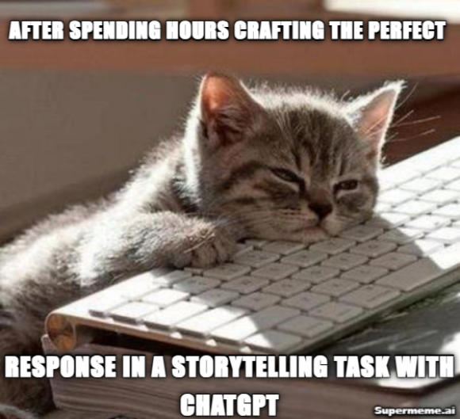
Collaborative writing with ChatGPT
Let's co-write a humorous parody of 'Pride and Prejudice' set in a modern city where cats rule the social scene. I'll start:
CREATIVE WRITING in TURNS with CHATGPT !

Slide 26
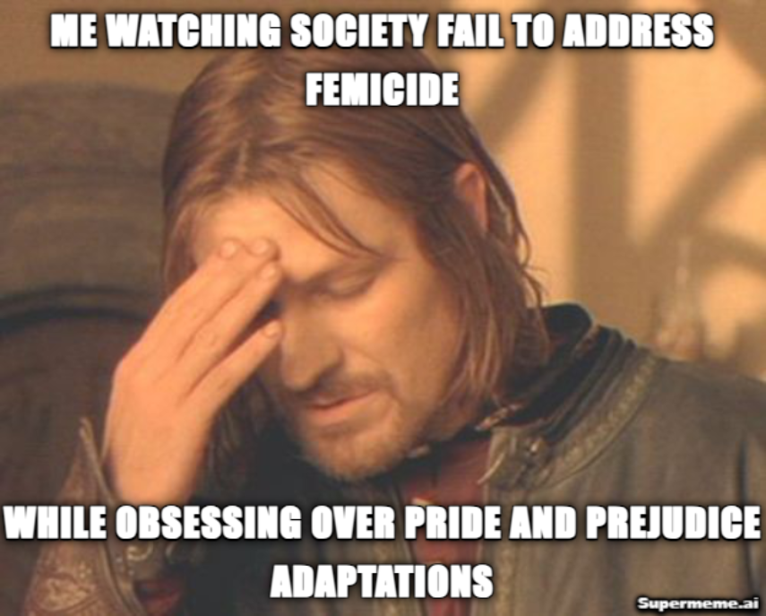
Class Debate
Search a template by describing emotions!

Slide 27
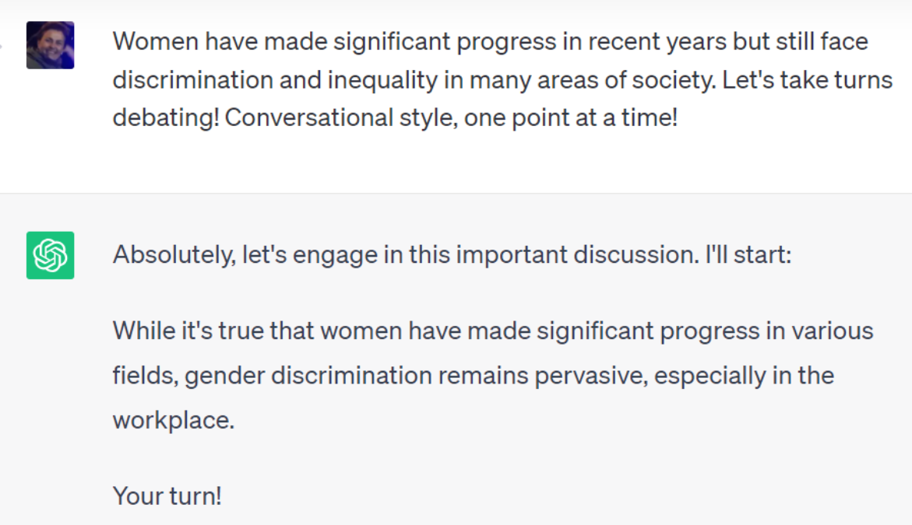
AI Debate

Slide 28
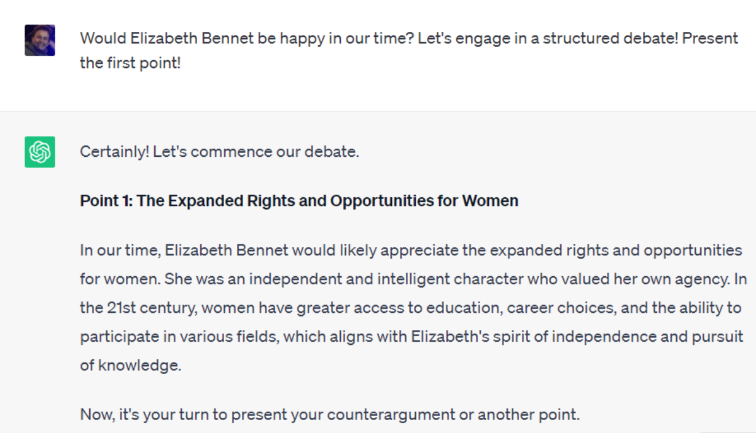

Slide 29
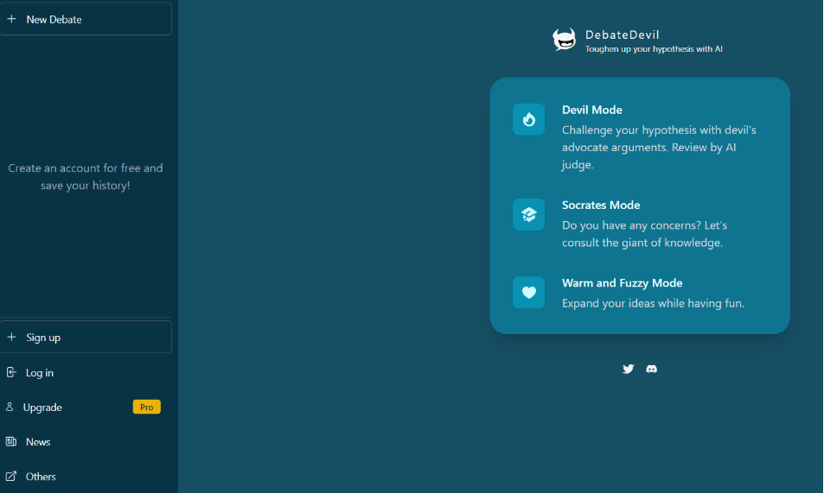
Devil,Socrates or warm&fuzzy mode…
https://www.debate-devil.com/en

Slide 30
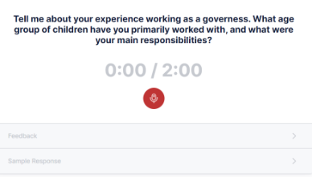
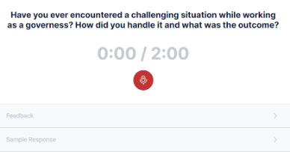
Elizabeth applies for a job…..
However, if we were to imagine a scenario where Elizabeth needed to work, given her intelligence, wit, and strong personality, she might find employment in a role that allows her to utilize her communication and social skills. Some possible roles could include being a governess, a companion to a wealthy lady, or a teacher at a girls' school. These roles were considered acceptable for women of the middle class at that time. (ChatGPT)
mock interviews with real-time feedback
relevant and realistic questions to practice with
speaking activity
voice recording
sample (improved) responses
https://interviewsby.ai/

Slide 31
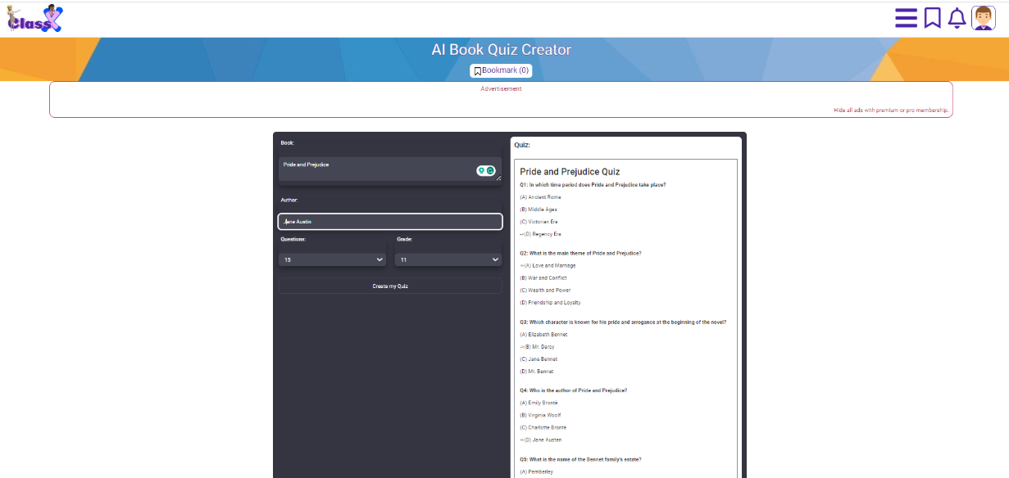
Assessment

Slide 32
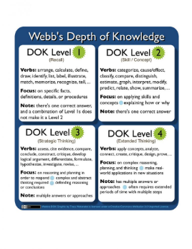
Depth of Knowledge (DOK) levels are a way of classifying questions based on the cognitive demand they require of the student.
There are four levels of DOK:
DOK 1: Recall and reproduction. Questions at this level require students to recall or reproduce information that they have learned.
DOK 2: Skill/Concept. Questions at this level require students to apply skills or concepts that they have learned.
DOK 3: Strategic Thinking. Questions at this level require students to think strategically and use higher-order thinking skills, such as analysis, synthesis, and evaluation.
DOK 4: Extended Thinking. Questions at this level require students to think creatively and critically about a problem or issue.
https://bard.google.com/

Slide 33
DOK 3 level questions for Pride and Prejudice:
DOK 4 level questions for Pride and Prejudice:
Analyze the relationship between Elizabeth Bennet and Mr. Darcy. How does their relationship develop over the course of the novel? What are the challenges they face? What are the factors that contribute to their eventual happiness?
How does Jane Austen use irony in Pride and Prejudice?
What are the social conventions that Jane Austen explores in Pride and Prejudice?
How does the novel challenge the traditional expectations of marriage?
Compare and contrast the characters of Elizabeth Bennet and Mr. Darcy. What are their similarities and differences? How do their personalities and values affect their interactions with each other?
What is the role of humor in Pride and Prejudice?
How does the novel explore the themes of pride and prejudice?
Discuss the role of social class in Pride and Prejudice. How does social class affect the relationships between the characters? What are the challenges faced by people of different social classes?
What is the significance of the title, Pride and Prejudice?
How does the novel reflect the social and historical context of its time?
What is the novel's lasting significance?
Evaluate the ending of Pride and Prejudice. Do you think it is a satisfying ending? Why or why not? What other possible endings could have been written?
How does the novel compare to other works of literature about love and marriage?
What are the novel's strengths and weaknesses?
Consider the themes of Pride and Prejudice. What are the main themes of the novel? How are these themes explored? What is the author's message?
Bloom’s Taxonomy is a framework to assist in instruction and when measuring the cognitive rigor of a lesson
Depth of Knowledge or DoK is another type of framework used to identify the level of rigor for an assessment

Slide 34
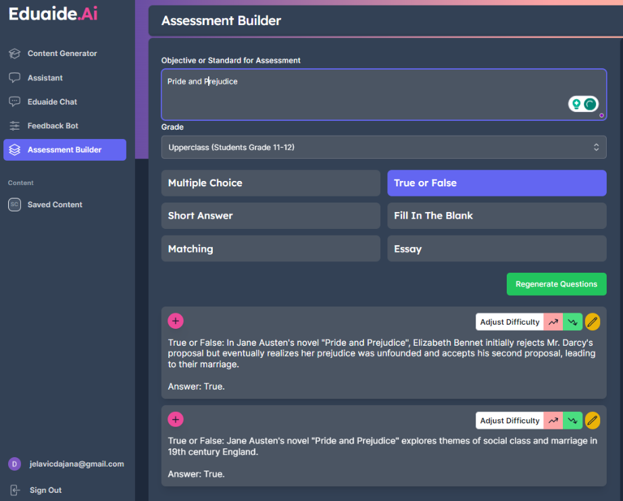
https://www.eduaide.ai/

Slide 35
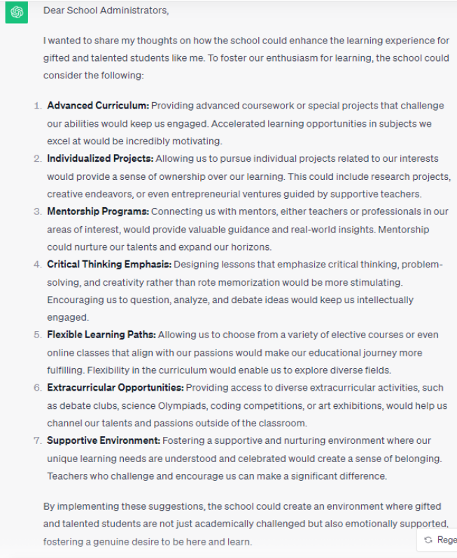
ChatGPT acts as a gifted student…

Slide 36
References
1."Supporting Gifted and Talented Students in Your Classroom" (course on European School Education Platform)
2.https://chat.openai.com/
3.https://gamma.app/
4.European Parliamenthttps://www.europarl.europa.eu/news/en/headlines/society/20200827STO85804/what-is-artificial-intelligence-and-how-is-it-used
5.AI-based tools
autoclassmate.io
chatGPT
classX
character.ai
bard
curipod
eduaide.AI
wepik.ai
conker.ai
studio.d-id
https://www.debate-devil.com/en
https://interviewsby.ai/
https://test-english.com/
https://pallyy.com/tools/tweet-generator

