Slide 1
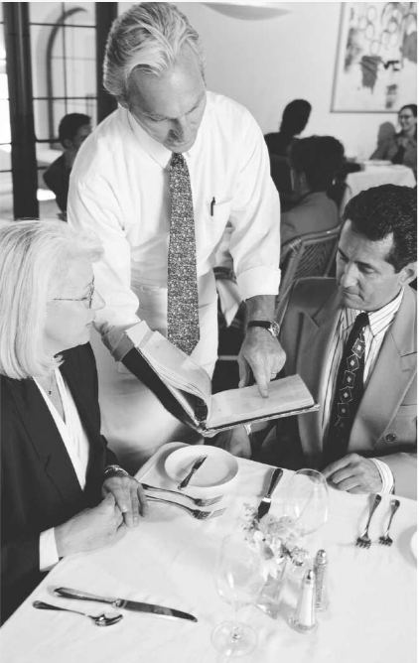
Speaking activity:
At the restaurant
Dajana Jelavic
NARRATED PRESENTATION

Slide 2
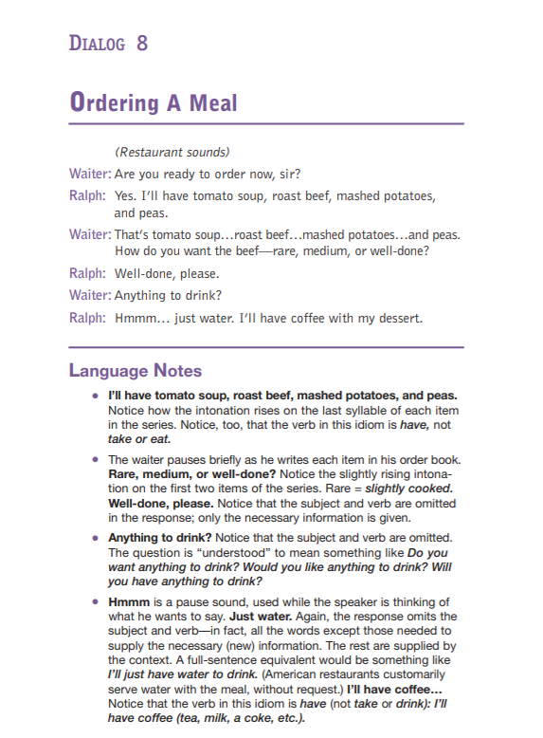
Resources:
FORVO,AmericanEnglishSpeakingResources,YouGlish
Develop speaking and listening skills
Improve accuracy and fluency
Emphasis on realism and naturalness(situation based dialogue)
Provide information on intonation patterns
Pronunced words/phrases in context

Slide 3
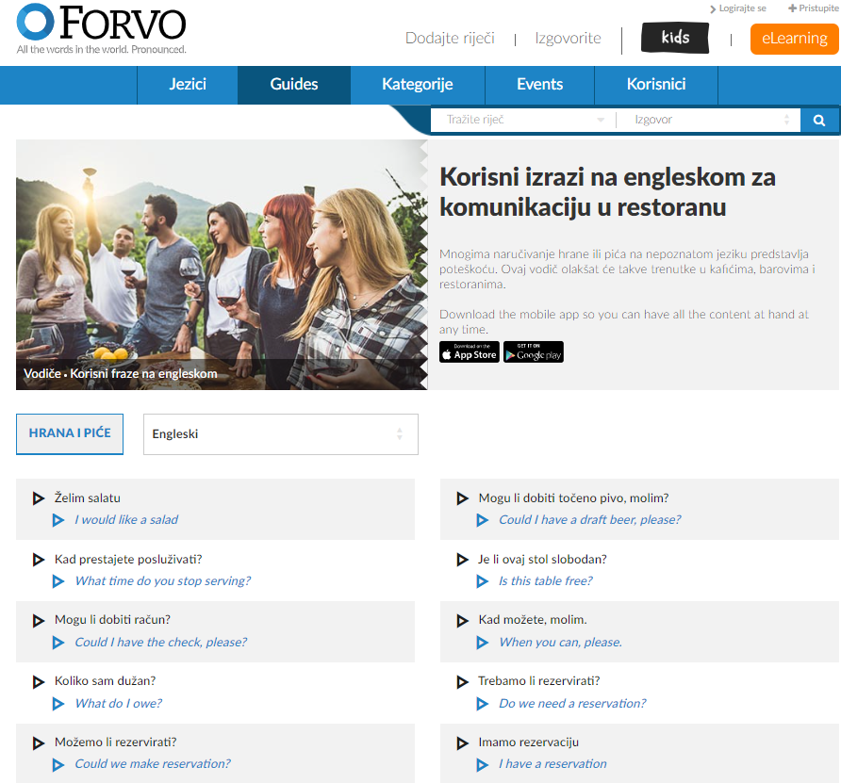
Dialogue at the restaurant
Waiter-customer
Useful phrases (fluency)
Ordering food and drink
Pronunciation and intonation(accuracy)
Comprehensibility

Slide 4

Activity outline:
Prior knowledge activation-picture description
Reading the dialogue+comprehension check
Language notes
Checking pronunciation with YouGlish
Phrase pronunciation with FORVO

Slide 5

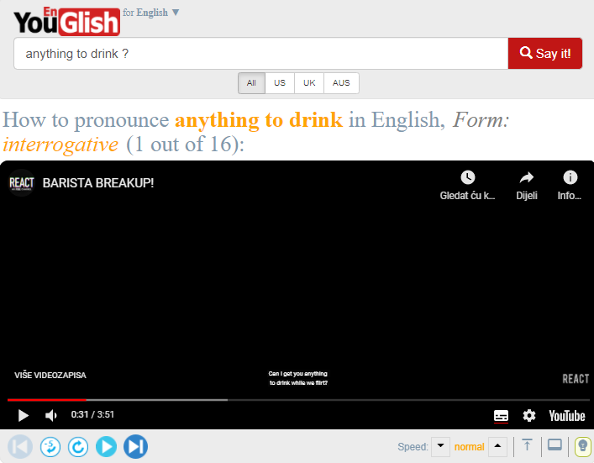
Activity outline:
Role-play (vegetarian/fish/meat menu/traditional Dalmatian menu)
Peer-evaluation(comprehensibility)
Pronunciation check with YouGlish
Repeated role-play
Homework

Slide 6
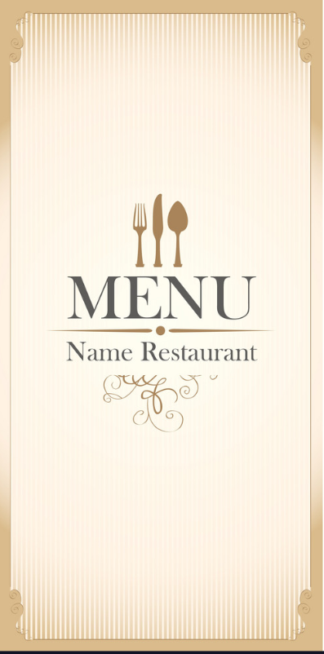
Homework:
Dishes on four different menus
Put the dishes into columns!
(VEGETARIAN,MEAT,FISH,DALMATIAN)
Compose your favourite menu!
Write a dialogue! (curious customer-patient waiter)

Slide 7
Learning outcomes:
By completing this speaking activity students
will enlarge their vocabulary
will develop critical thinking,creativity and collaboration
will improve their speaking ability (fluency and
comprehensibility)
will be able to access and reuse resources

